Slide 1



Applied DATA SCIENCE PROJECT Multi-task learning for fire ignition maps

Slide 2



VALUE-DRIVEN PROJECT
Semantic Segmentation objective is to assign a label to each pixel of an image from a predefined set of classes.
Multi-task learning objective is to train a model on multiple tasks at the same time trying to get the best of all for the main task
The aim of this project is to develop a Multi-task segmentation model for burned area delineation

Slide 3
Data
We will use a catalog of 2152 fires happened in Piemonte region (Italy) in 2012-2024.
For each fire event, the following data are available
Sentinel-2 L2A images
Landsat images
Copernicus Digital Elevation Model
Copernicus ERA5 Weather data
Piedmont streets data
Dynamic World Land Cover
Burned area delineation mask (Ground truth)

Slide 4
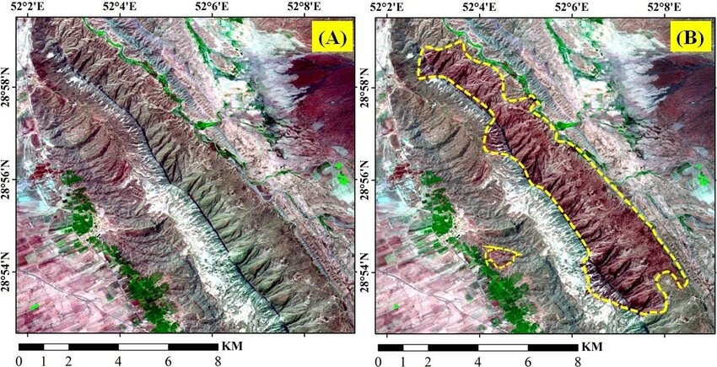
TASK
The objective is to obtain the delineation of the final burned area starting from the ignition point
Try the following auxiliary tasks able to improve performance on this task
Land cover segmentation
ERA5 Data forecast
If you have ideas, they’re more than welcome!
Ignition point

Slide 5
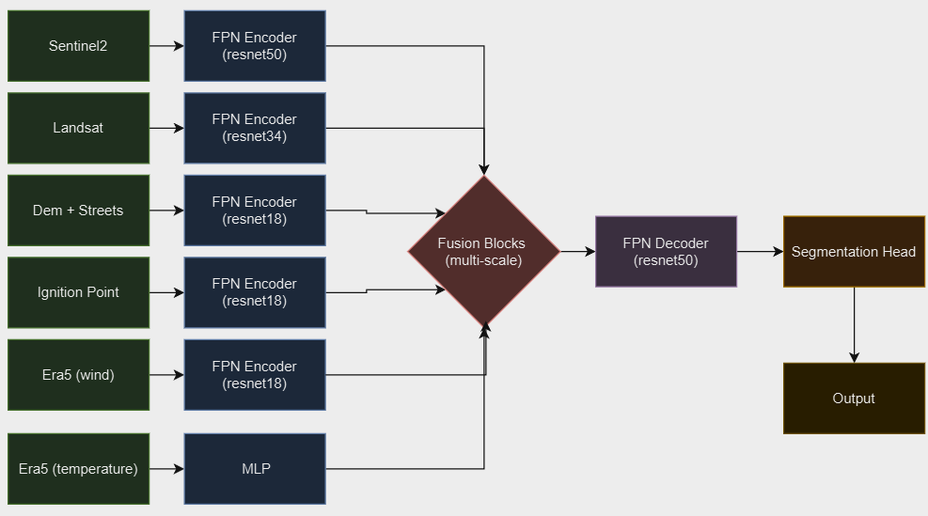
TASK
Expand the following architecture for single task to multi-task (i.e. adding another segmentation head)

Slide 6
LIGHT MENTORING
Mentors
Luca Barco luca.barco@linksfoundation.com
Weekly one-hour calls with students for the whole duration of the semester
Feel free to reach out via Slack or email at any time for any questions or doubts

Slide 7
POLICY
Both project descriptions and implementations will be part of a repository group published on GitHub
The repositories will be public

